Slide 1
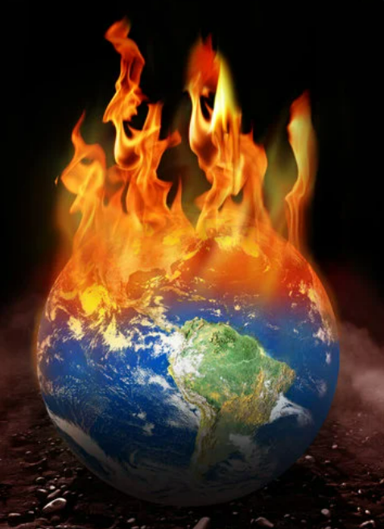
Global Warming:
An Urgent Challenge
Global warming refers to the long-term increase in Earth’s average surface temperature due to human activities
primarily the emission of greenhouse gases

Slide 2
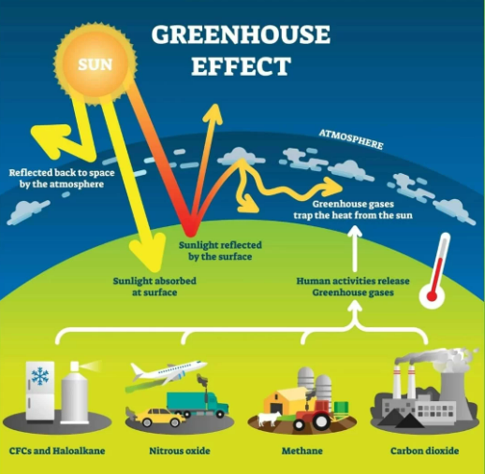
Greenhouse Gases and Their Impact
Greenhouse Gases
Carbon dioxide (CO2), methane (CH4), nitrous oxide (N2O), and fluorinated gases are major contributors to global warming.
Impact
These gases trap heat in the atmosphere, causing the planet to warm at an unprecedented rate.

Slide 3
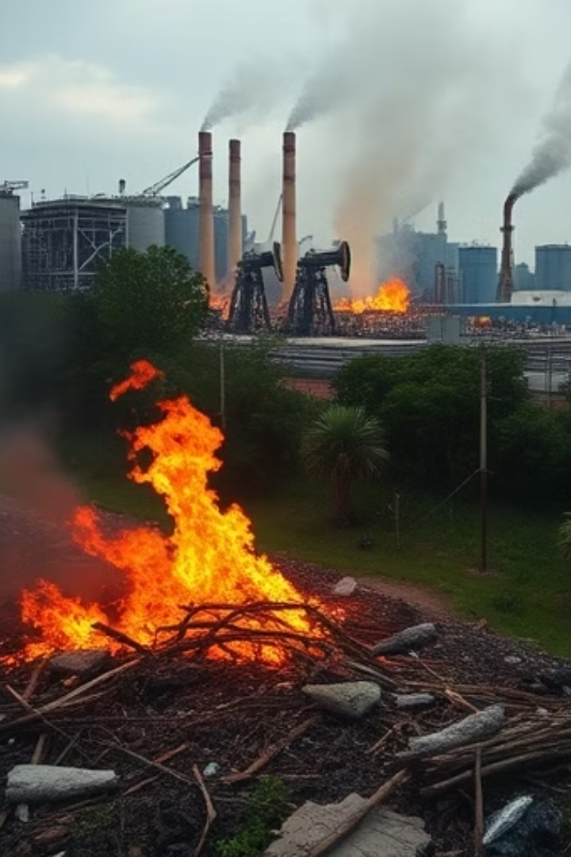
Causes of Global Warming
1
Fossil Fuel Burning
The combustion of fossil fuels like coal, oil, and natural gas releases carbon dioxide, a major greenhouse gas.
2
Deforestation
Trees absorb carbon dioxide from the atmosphere; their removal disrupts this balance, contributing to warming.
3
Industrial Processes
Industrial activities release various greenhouse gases, including methane and nitrous oxide, contributing to the warming effect.
4
Waste Management
Improper disposal of waste, especially in landfills, can lead to the release of methane, a potent greenhouse gas.

Slide 4
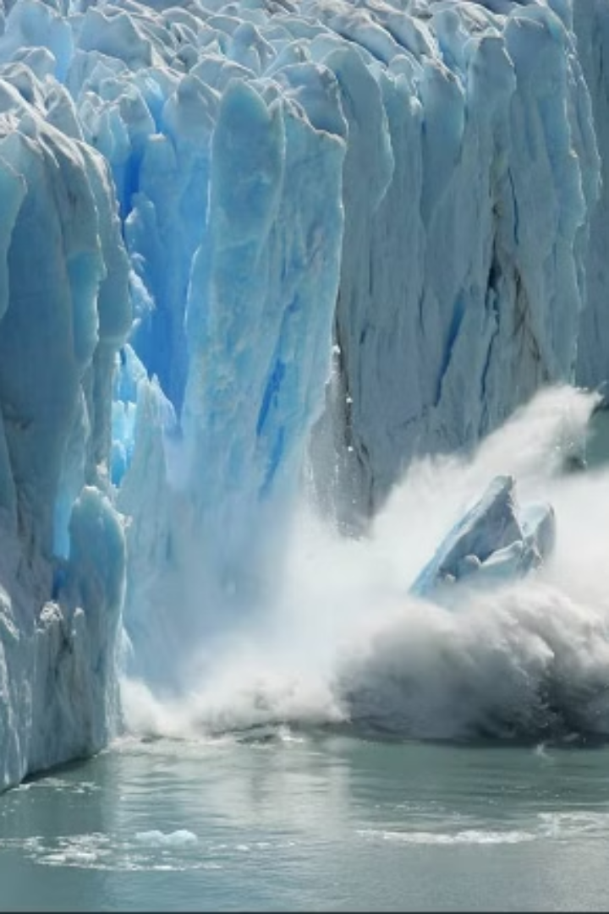
Impacts of Global Warming
Melting Glaciers
Rising temperatures cause glaciers and ice sheets to melt at an accelerated rate, adding water to the oceans.
Sea Level Rise
The influx of water from melting glaciers and ice sheets causes sea levels to rise, threatening coastal communities and ecosystems.
Coastal Impacts
Rising sea levels can cause coastal erosion, flooding, and saltwater intrusion, impacting infrastructure, homes, and businesses.

Slide 5
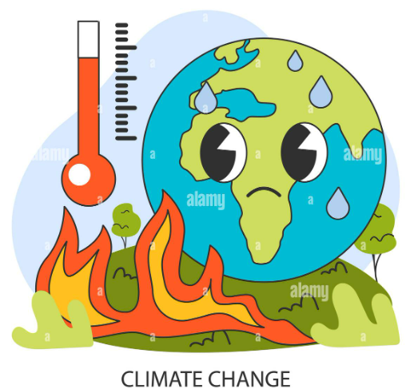
Rising Temperatures and Climate Change
1
1850-1900
The pre-industrial period, a baseline for comparison, with relatively stable global temperatures.
2
1900-Present
Global temperatures have been rising steadily, with an acceleration in recent decades due to increased greenhouse gas emissions.
3
Future Projections
Scientific models predict continued warming, with potentially severe consequences if emissions are not curbed.
The rise in global temperatures is a direct consequence of the increasing concentration of greenhouse gases in the atmosphere. This phenomenon, known as global warming, is a significant driver of climate change.

Slide 6
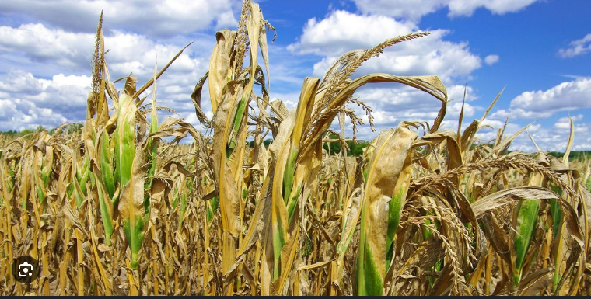
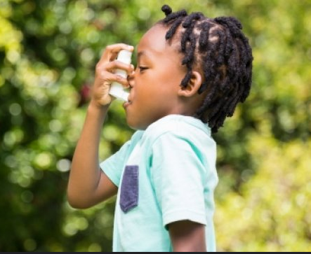
Agricultural Challenges
Changes in weather patterns affect crop yields and food production, leading to food shortages and higher prices.
Impact on Human Health
Rising temperatures increase the incidence of heat-related illnesses and infectious diseases.
Vector-Borne Diseases
Respiratory Diseases
Cardiovascular Diseases

Slide 7
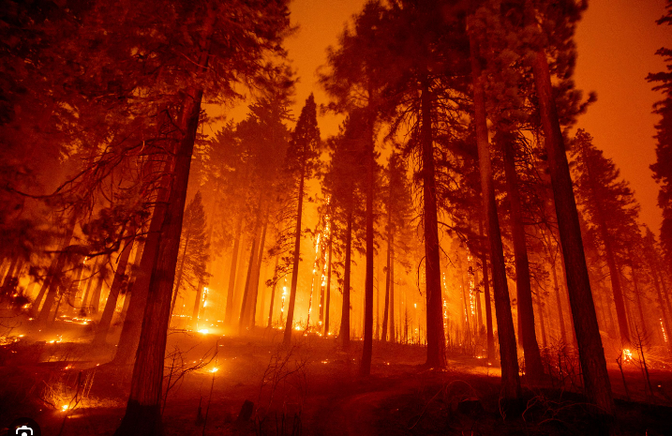
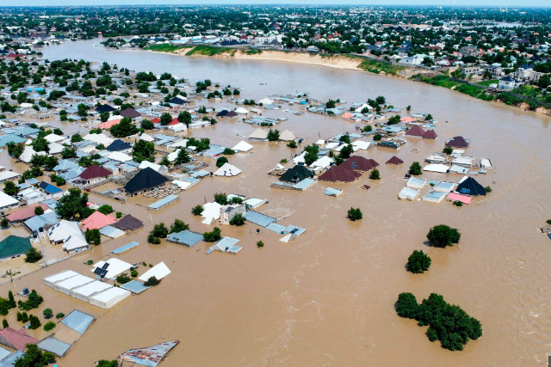
Extreme Weather Events and Natural Disasters
Wildfires
Drier conditions and higher temperatures increase the risk of wildfires, causing widespread destruction.
Flooding
Heavier rainfall and rising sea levels lead to more frequent and intense flooding, displacing communities.

Slide 8



Impacts on Ecosystems and Biodiversity
Ocean Acidification
Increased carbon dioxide in the atmosphere makes oceans more acidic, harming marine life, particularly coral reefs.
Species Migration
Climate change disrupts natural patterns, forcing species to migrate to new areas, leading to imbalances in ecosystems.

Slide 9
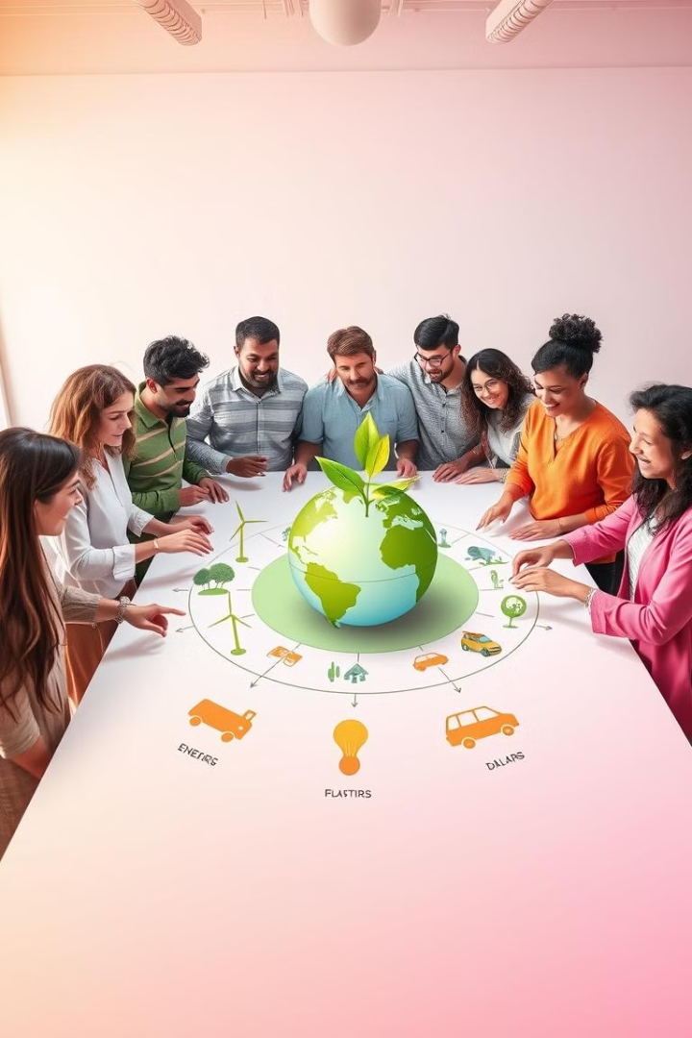
Strategies for Mitigating and Adapting to Global Warming
1
Switch to Renewable Energy
Transitioning to clean energy sources like solar, wind, and hydropower can reduce dependence on fossil fuels and cut greenhouse gas emissions.
2
Afforestation
Planting trees and promoting sustainable agriculture can help absorb carbon dioxide from the atmosphere, mitigating global warming.
3
Reduce, Reuse, Recycle
Minimizing waste and promoting recycling can reduce the amount of waste sent to landfills, thereby lowering methane emissions.
4
International Cooperation
Global collaboration is essential for addressing climate change, sharing knowledge, resources, and technology to find solutions.

Slide 10


